Slide 1
SoC Lab3實驗報告
授課老師：陳朝烈 教授
學號：F107112107
學生：黃柏儒

Slide 2
Zynq-7000手冊資料
Zynq-7000 SoC Technical Reference Manual (UG585)
URL : https://www.xilinx.com/support/documentation/user_guides/ug585-Zynq-7000-TRM.pdf

Slide 3
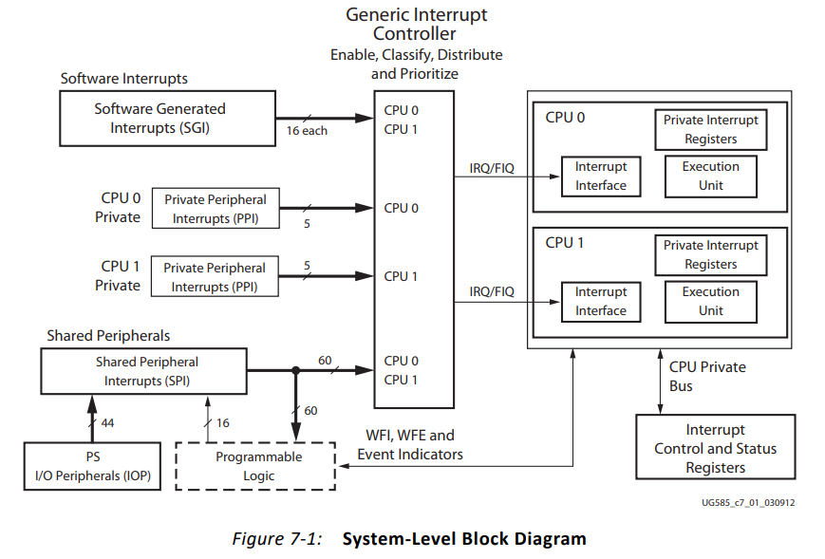
中斷架構

Slide 4
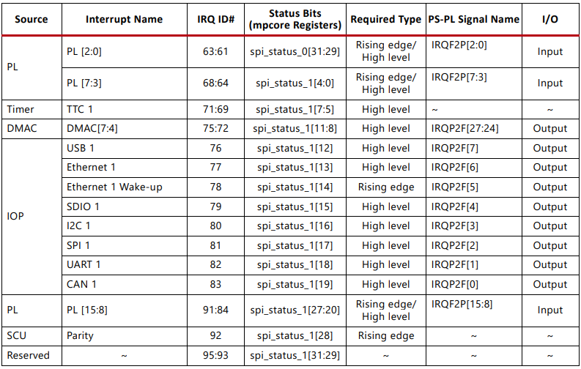
IRQ ID # (Page 231)

Slide 5

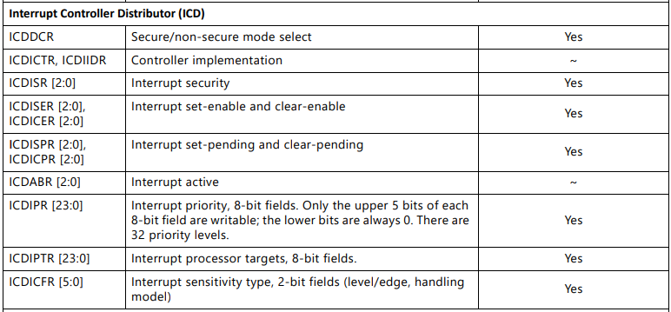
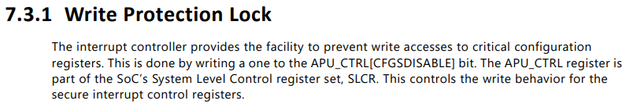
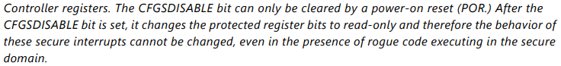
Interrupt Pending & Enable overview (Page 234)

Slide 6
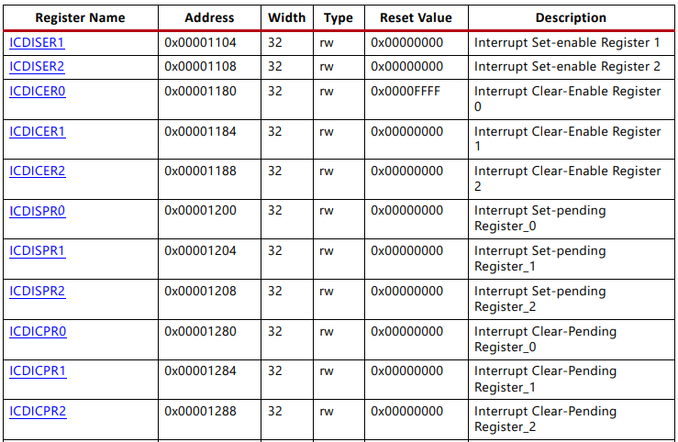
Interrupt Pending Register (Page 1432)

Slide 7


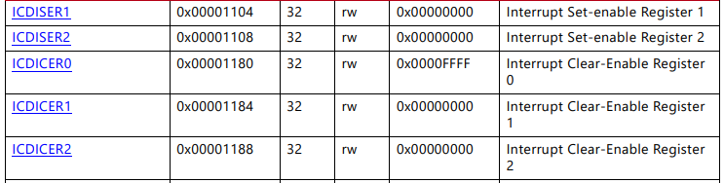
Interrupt Enable (Page 1431~1432)

Slide 8
找 External Interrupt for button
(1) IRQ # : 61
(2) 狀態暫存器:
Set-pending : ICDISPR [2:0]
Clear-pending : ICDICPR [2:0]
(3)Enable Register :
Set-enable : ICDISER [2:0]
Clear-enable : ICDICER [2:0]

Slide 9
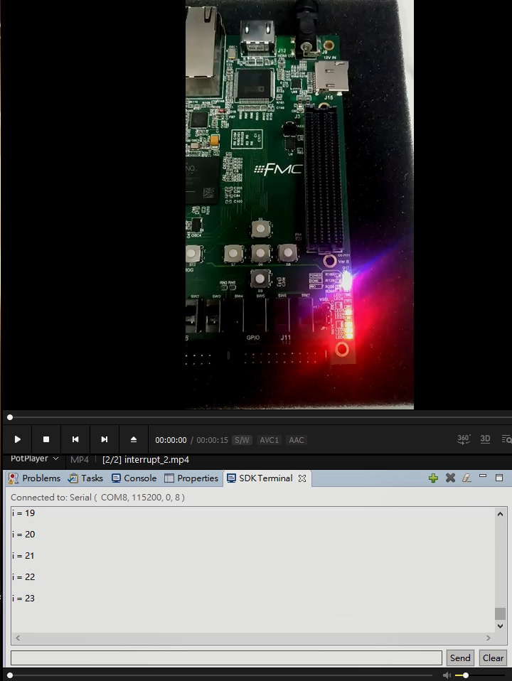
Demo影片(中斷)
按下按鈕後中斷，LED會閃爍兩次後繼續計數

